Slide 1
3CTN Ask Me Campaign
Training Slides

Slide 2
Introduction
3CTN’s Vision
Canadians will have access to the best available cancer treatments through successful execution of academic clinical trials;
3CTN Objectives
3CTN’s Mission
To ensure access to and efficient execution of ACCTs across the Network;
To improve patient access to academic clinical trials that will improve recruitment to Portfolio of trials to 75% above the pre-3CTN baseline
To enhance PPI across all sites by providing incentives and assistance to sites for the development and implementation of PPI strategies
To improve trial performance by focusing on improving trial initiation timelines, recruitment projections and quality initiatives
To optimize the 3CTN trial Portfolio to create opportunities for new trials and demonstrate its impact

Slide 3
Introduction – Cont’d
To improve patient access to academic clinical trials;
  Improve patient access and recruitment to the 3CTN Portfolio of trials:
    Network Targets to increase recruitment by*:
          55% by 31-Mar-2019
          60% by 31-Mar-2020
          65% by 31-Mar-2021
          75% by 31-Mar-2022
*Note: Exact targets vary centre to centre based on negotiated contract
3CTN Ask Me Campaign Training Slides • May 2019

Slide 4
3CTN’s Recruitment Initiatives
3CTN Coordinating Centre focusing on a number of initiatives to tackle this multifaceted issue
The 3CTN ASK ME Campaign is one tool the sites can use to raise trial awareness among patients, in particular cancer patients
Purpose:
  Increase public awareness of clinical trials in the cancer centres
  Get patients and staff talking about clinical trials
    Patients can consider clinical trials as a potential cancer treatment option
  Encourages patients to approach staff about clinical trials
    Assist with dispelling any misconceptions around cancer clinical trials
    Increase access to cancer clinical trial resources
3CTN Ask Me Campaign Training Slides • May 2019

Slide 5
Ask Me Campaign Tools
Material | Description | Target Audience
Roll Out Instruction Sheet | An instruction sheet, outlining each item in the Ask Me Campaign and describing roll out at the sites | NCC, NACC Managers One key contact at each site for roll out
Training Slides | For sites to train site staff on the Ask Me campaign | Staff
Fact Sheet | A brief, one page fact sheet about the Ask Me Campaign can be placed on bulletin boards or in staff clinic areas to raise awareness of campaign among staff/physicians | PI, Site staff, Executives
Buttons | “Ask me about clinical trials” buttons available in EN and FR. Buttons are worn by clinical trials staff, physicians and volunteers. | Patient, public
Posters | Available in EN and FR | Patient, public
N2 Brochure | The N2 clinical trials brochure, available in EN and FR Sites can print locally to put in waiting rooms or other patient areas | Patient, public
Resource Card | A card about clinical trials to handout to patients that you are speaking with Contains website information where patients can go for more education | Patient, public
3CTN Ask Me Campaign Training Slides • May 2019

Slide 6
Ask Me Campaign - Procedure
Once appropriate individuals are trained and wearing their buttons
Buttons/poster should catalyze an increase in patients asking health care team (or anyone wearing the button) about clinical trials
Staff or other personnel wearing the button can encourage any of the following:
  Have a conversation with patients and their families about clinical trials;
  Encourage patients to speak with their healthcare team about clinical trials and where to find cancer clinical trials;
  Hand the Resource Card out and encourage patients to visit the educational websites for more information and for a listing of available cancer clinical trials;
    examples on next 3 slides
REMEMBER:
The most important part of this campaign is for individuals wearing the button to know where to direct patients for more information!
3CTN Ask Me Campaign Training Slides • May 2019

Slide 7
ItStartsWithMe.ca/CaCommenceAvecMoi.ca
Launched by 3CTN’s partner (Network of Networks)
Aimed at increasing clinical trial awareness and knowledge
  General clinical trial education website
    Not cancer trial specific
  Patient/care-giver focused
    Meant as an entry point into the ‘world’ of clinical trials
  Written in a ‘conversational’ tone to invite a visitor to the site to learn more about trials
    Input from patients/families so appropriate language and level of understanding was considered
English and French versions
Short video about trials add to homepage
  close captioned available
  may also be used on your institution’s website
3CTN Ask Me Campaign Training Slides • May 2019

Slide 8
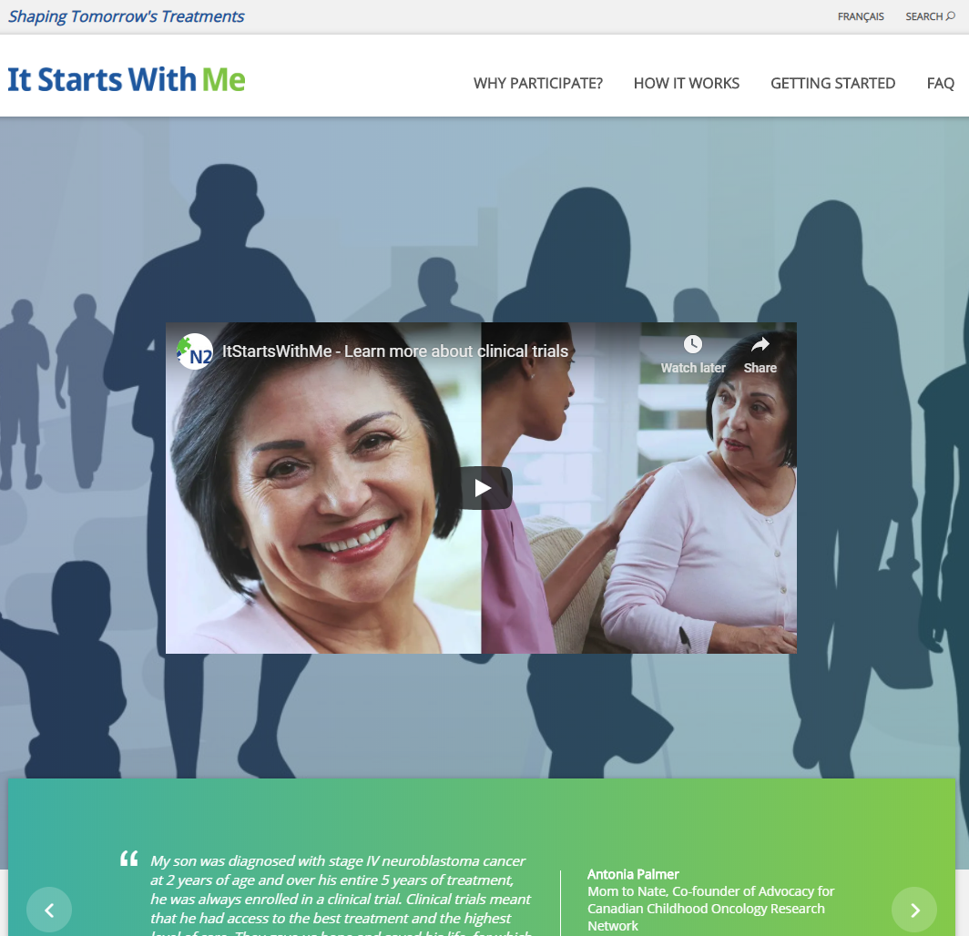
ItStartsWithMe.ca/CaCommenceAvecMoi.ca
3CTN Ask Me Campaign Training Slides • May 2019

Slide 9
Local Websites, Contacts or Resources for Patients
Local resources and websites are posted on 3CTN.ca
  Resource Card directs patient to 3CTN.ca
(to be updated by local staff prior to campaign roll out)
3CTN Ask Me Campaign Training Slides • May 2019

Slide 10
Metrics
(If collecting additional metrics, list here)
3CTN Ask Me Campaign Training Slides • May 2019

Slide 11
‘Ask Me’ Campaign – Reminders & Other Considerations
The “Ask Me” campaign is one element of a larger initiative by 3CTN to assist with increasing recruitment
Main focus of the campaign is starting the conversation:
  Get patients asking about trials, considering trials as a potential cancer treatment option and knowing where to find cancer clinical trials
Making staff aware of exactly what to say and where to direct the patients is JUST as important as staff wearing the buttons
Don’t forget!
Print out brochures/poster and put them in patient areas (example: waiting rooms)
Consider using these “Ask Me” materials to facilitate a PPI event at your site!
3CTN Ask Me Campaign Training Slides • May 2019

Slide 12
Thank you!
Further questions about the ASK ME Campaign can be directed to the 3CTN Coordinating Centre (info@3ctn.ca)
3CTN Ask Me Campaign Training Slides • May 2019

